Slide 1
Nearest Neighbor: KD Trees v. LSH
William Agnew, Alex Gurney, Colby Wolfe

Slide 2
What is the Nearest Neighbor Problem?
Given a set of d-dimensional real points, a distance function that maps two points to a real, and a d-dimensional query point q, the nearest neighbor problem is to find the s in S that minimizes the distance function for inputs s and q.
Here we assume the distance function to be the Euclidean distance.

Slide 3
What are KD-Trees?
KD trees are best thought of as binary trees in d dimensions.
At each level, points are sorted by comparing along one dimension

Slide 4
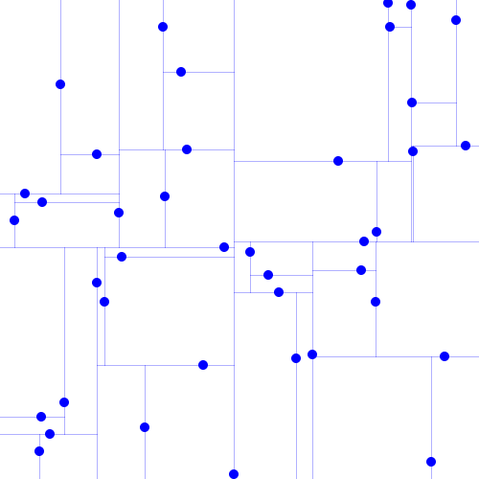
Nearest Neighbor Search in KD Trees

Slide 5

Nearest Neighbor Search in KD Trees

Slide 6
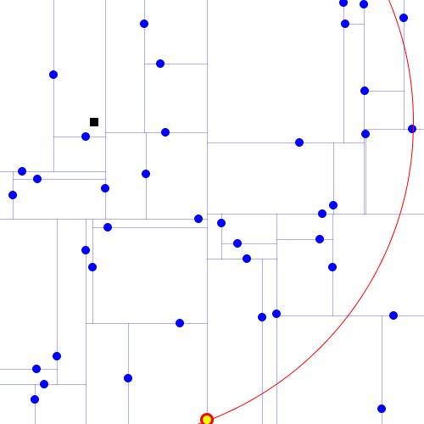
Nearest Neighbor Search in KD Trees

Slide 7
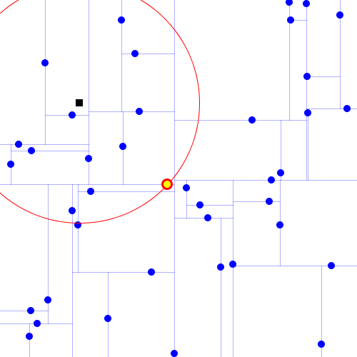
Nearest Neighbor Search in KD Trees

Slide 8
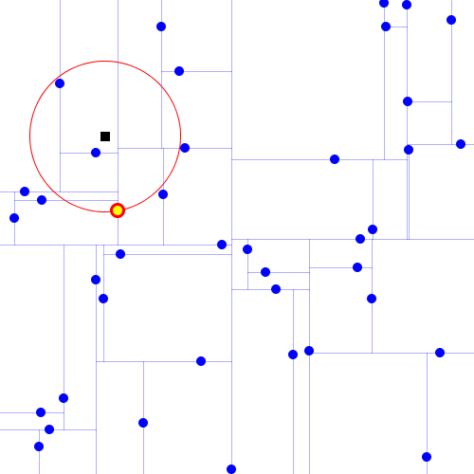
Nearest Neighbor Search in KD Trees

Slide 9
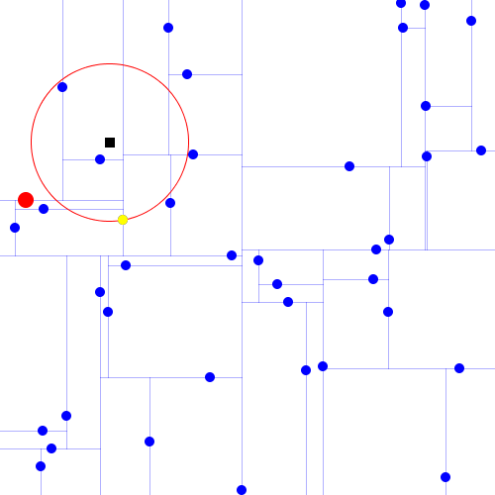
Nearest Neighbor Search in KD Trees

Slide 10
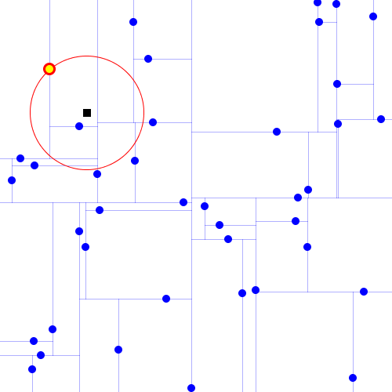
Nearest Neighbor Search in KD Trees

Slide 11
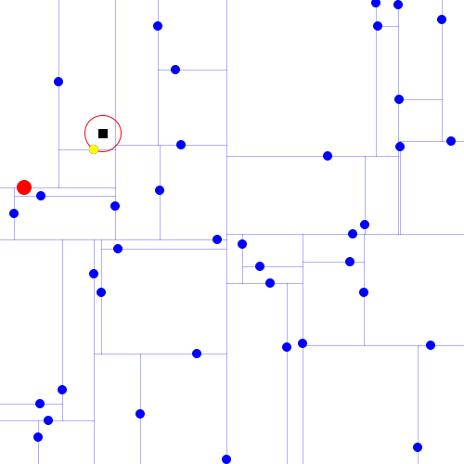
Nearest Neighbor Search in KD Trees

Slide 12
Nearest Neighbor Search in KD Trees

Slide 13
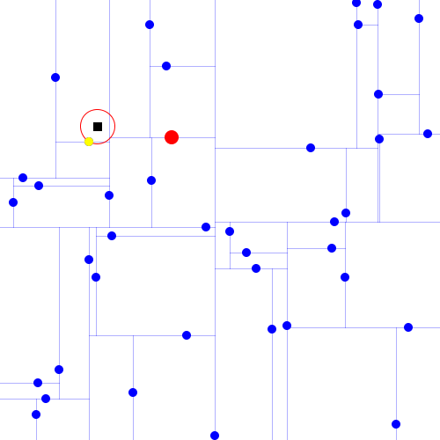
Nearest Neighbor Search in KD Trees

Slide 14
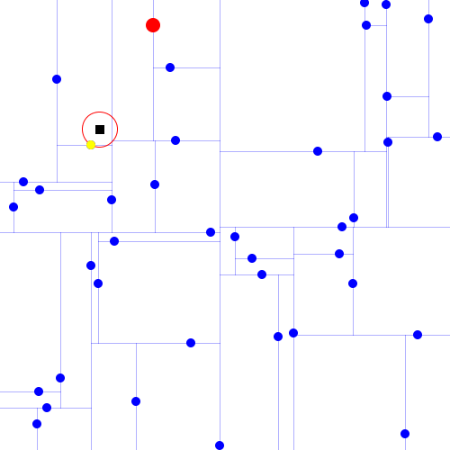
Nearest Neighbor Search in KD Trees

Slide 15
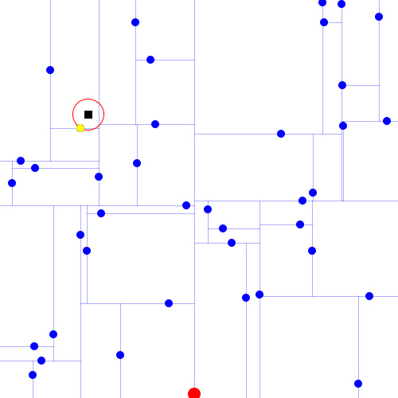
Nearest Neighbor Search in KD Trees

Slide 16
Nearest Neighbor Search in KD Trees
O(log n), where n is the size of the set being search on, but only for n>>2^{dimensionality}: for smaller n, very few points are eliminated on each bound.
Therefore, not very good for high dimensions

Slide 17
Locality Sensitive Hashing (LSH)
Hash points into buckets so that close points are often in the same bucket, and distant points are rarely in the same bucket
Reduce dimensionally of points by projecting with a random matrix into a lower dimension

Slide 18
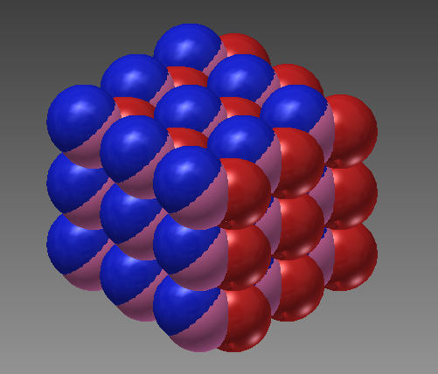
Locality Sensitive Hashing (LSH)
Hash function we used is composed of offset grids of hyperspheres in 24 dimensions
Each hypersphere is a bucket

Slide 19
Locality Sensitive Hashing (LSH)
Problem: If the query point only hashes into empty buckets, no neighbors are found
Solution: Have multiple LSH instances with different bucket sizes (hypersphere radii), search largest (least specific) to smallest that returns neighbors

Slide 20
Lattice Decoding?!
Hashing a point to a bucket requires finding the closest point in the Leech lattice to that point.
Common problem in coding theory, fast, good approximate solutions for Leech lattice
Known as the closest vector problem in cryptography; solving this efficiently would break lattice-based cryptography! Oh no!
Nearest Neighbor (on lattices) could be used to do the same thing!

Slide 21
Implementations
Implemented KD Trees and LSH in Java

Slide 22
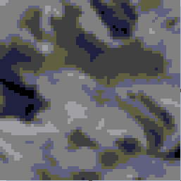
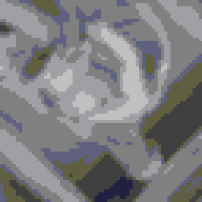
Experiments
Goal: Show difference between KD Trees and LSH: KD Trees perform poorly in high dimensions, LSH performs well in all dimensions
Used both implementations to search in a variety of dimensions and search set sizes

Slide 23
Results

Slide 24
Discussion
KD Tree’s run time blows up for high dimensions, but this is only reflected for tests with large number of search points
LSH’s performance degrades logarithmically with the number of points and linearly with the dimension

